Slide 1



UNIT 1
LESSON 3
ALL THAT GLITTERS
Part 3

Slide 2
1 Greedy people always ...
2 It’s OK/It’s not OK to receive punishment if you …
3 We should offer our hospitality to ...
4 Wealth is...
5 I usually bitterly regret it when ...
6 Children should get a reward when ...
7 If you’re under a curse, ...
8 I always give comfort to ...
9 When people feel desperate they often ...
10 We should take pity on ..
I hate people which have a good sense of humour.
I hate people who have a good sense of humour.

Slide 3

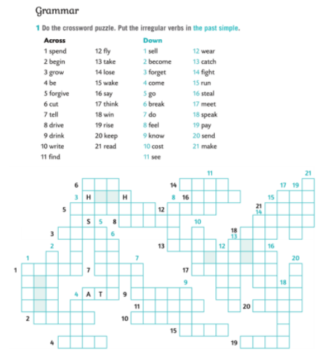
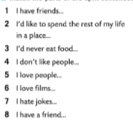
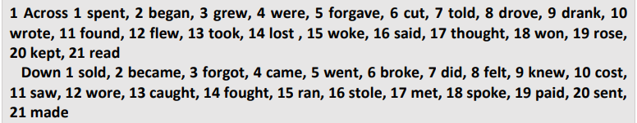

Slide 4
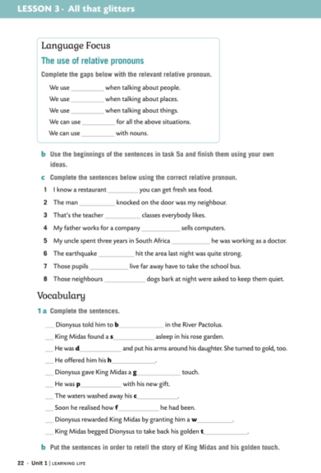
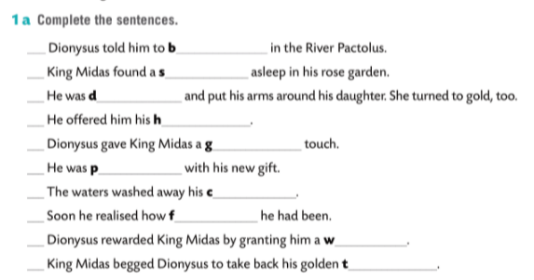
athe
atyr
espair
ospitality
olden
leased
urse
oolish
ish
ouch

Slide 5
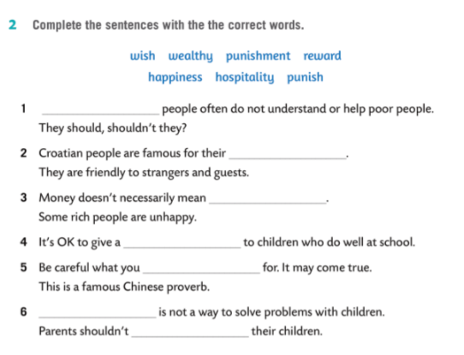
King Midas found a satyr in his garden.
Wealthy
hospitality
Who found a satyr in the garden?
Who did he find in his garden?
happiness
reward
wish
Punishment
punish

Slide 6
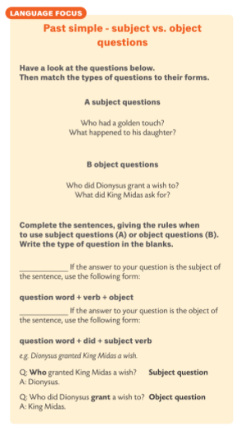

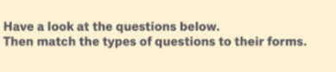
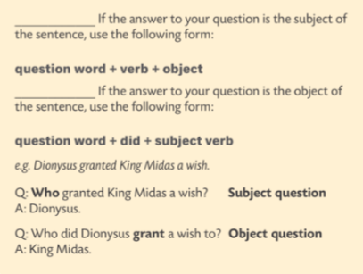
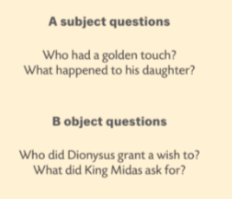
A
B

Slide 7
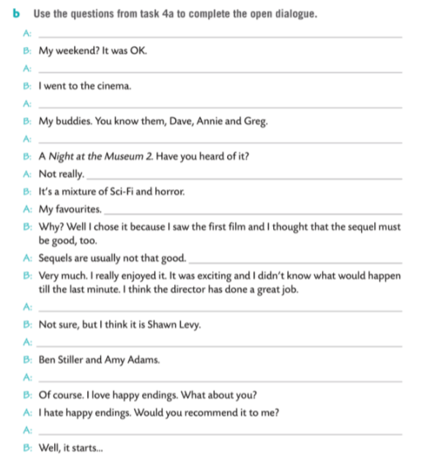
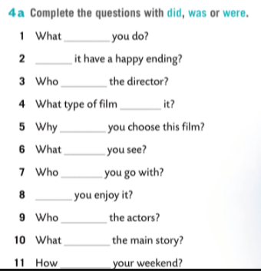
How was your weekend?
What did you do?
Who did you go with?
did
What did you see?
Did
was
What type of film was it?
was
Why did you choose this film?
did
did
Did you enjoy it?
did
Did
Who was the director?
were
Who were the actors?
was
Did it have a happy ending?
was
What was the main story?

